Slide 1

NISA
N-ALM Oslo Nov 21, 2017
www.cleancluster/NISA Martin Porsgaard map@cleancluster.dk

Slide 2

We are:
An association: Working to promote and develop a more sustainable aviation industry
Main purposes: Facilitate, coordinate and push forward the development of sustainable and alternative fuel for the aviation industry
Committed to: Decarbonization

Slide 3
Organization
A
SAS*
Swedavia*
Avinor*
Copenhagen Airports *
Airbus*
Boeing*
Finnair*
Finavia*
Atlantic Airways*
Air Greenland*
Icelandair*
NHO-Norsk Luftfart*
DI/Danish Aviation/BDL*
TUI Fly Nordic
IATA
Svenskt Flyg
FlygBranschen
Ministry of Transport FL
Danish Transport Authority
Isavia, Reykjavík
Swedish Transport Agency
Energimyndigheten SW
Energistyrelsen DK
Associate Members/stakeh
Aviation /Full Members*
AIRBUS
AVINOR
C COPENHAGEN AIRPORTS
FINNAIR
SAS
SWEDAVIA
The Board
Project
Management
MP
____________________________________________________________________________________________________________________
www.cleancluster.dk/nisa
.

Slide 4
Recommendations from NISA & NER seminar Oct 10, 2017
The Organizers; Nordic Energy Research, Nordic Council of Ministers in corporation with NISA concluded the conference by presenting core observations as message to politicians in the Nordic countries with elements for a political framework and the urgent need for an action plan:
Include aviation in National Energy Plans which also includes for the EU (winter package) /RED 2 Encourage corporate, private and public use of sustainable jet fuels (a Nordic Fly Green Fund?)
Include sustainable jet fuel in public procurement with sustainability criteria (military and public entities )
Explore opportunities public-private partnerships to establish fund, grant, pilot/demo plants a.m.
Consider introducing a pan-Nordic blending requirements similar to the emerging Norwegian blend-in plan
Evaluate (Nordic) market opportunities, could be a pre-qualification- or tender process, procurement requirements
High priority to negotiations on aviation- and climate issues in international bodies

Slide 5
Criteria, calculations, certifications to be coordinated
ICAO/CORSIA, IPCC, IATA, EU-RED2, approved bodies and NGO’s
Sustainable jetfuel – CO2 reduction 50-80% (35-85?)
Other climate affecting emissions
  Biofuels do not contain sulfur compounds - not emit sulfur dioxide
  Biofuels 'could (?) limit jet contrails, because of less soot particles
  Biodiesel has a higher cetane rating than petrodiesel, which can (?) improve performance and clean up emissions compared to crude petro-diesel.
  Biodiesel contains (?) fewer aromatic hydrocarbons: benzofluoranthene: 56% reduction; Benzopyrenes: 71% reduction
  Ultrafine particles
Sustainability criteria/definitions, decissions and developments
  Palm oil, tobacco plants, eucalyptus, jatropha, camelina, forrest, land use, algae, used cooking oils, corn, straw, waste from household and industry etc
Other alternatives such as electrofuels
  Power to Liquid by capture CO2 and convert into syngas
Electricity as power supply
  Zunum Aero/Boeing, Airbus/Siemens, NASA, Lillium Aviation and others…..

Slide 6

Global aviation
_______________________________________________________________________________
Growth
4-5% per year
The industry
has a big responsibility
700 mil tons
CO2 (2014)
Goal
Make aviation sustainable
2% of human made CO2
…also climate and
environment
An essential part
of the transport sector

Slide 7

The climate challenge
_______________________________________________________________________________
The challenge is global
70% improved
fuel efficiency over the past 55 years
Need for
international regulations
1-1,5%
techn. improvements
per year
Aviation included:
-EU emission trading/ETS
-ICAO’s CORSIA
(Carbon Offsetting and Reduction Scheme
for International Aviation)
-CO2 standard for nye fly
The Industry
activ on goals and improvement plans
CO2 accreditation
AIC/airports

Slide 8

Climate activity plan
_______________________________________________________________________________
1 - 1,5% Improvements per year
CO2 neutral growth from 2020
Minus 50% CO2 in 2050
Technology and biofuels
Operative improvements
Infrastructure improvements
Market instruments

Slide 9
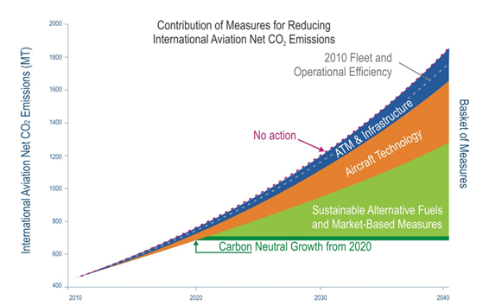

Slide 10

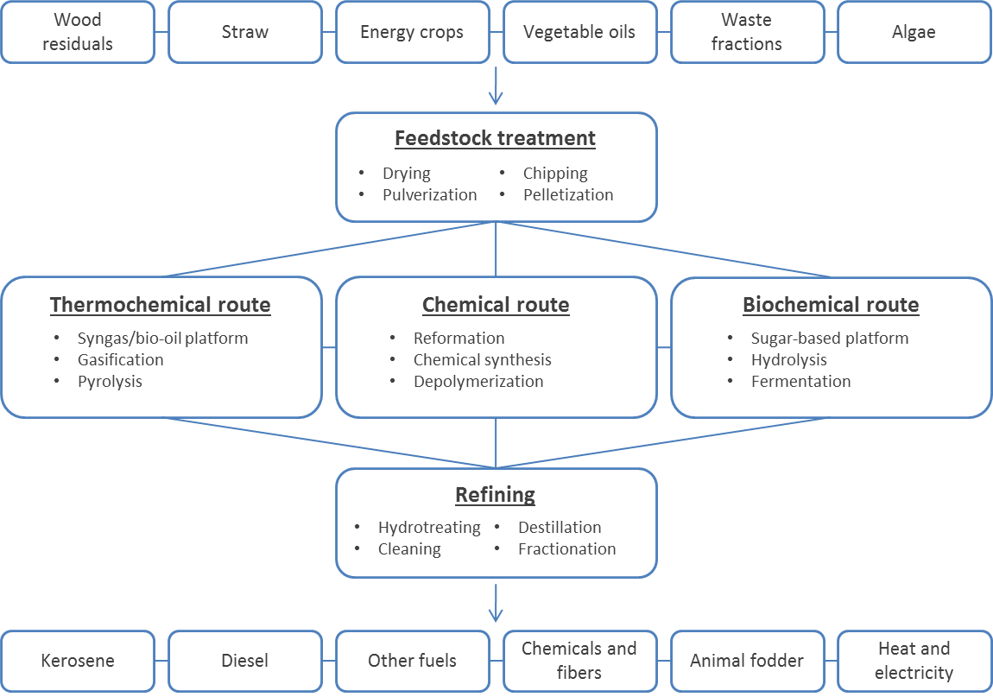
Biofuel Production steps
Different routes to produce biofuels and other products
The four basic steps in a feedstock to fuel pathway.

Slide 11


Nordic perspectives on the use of advanced sustainable jet fuel for aviation

Slide 12
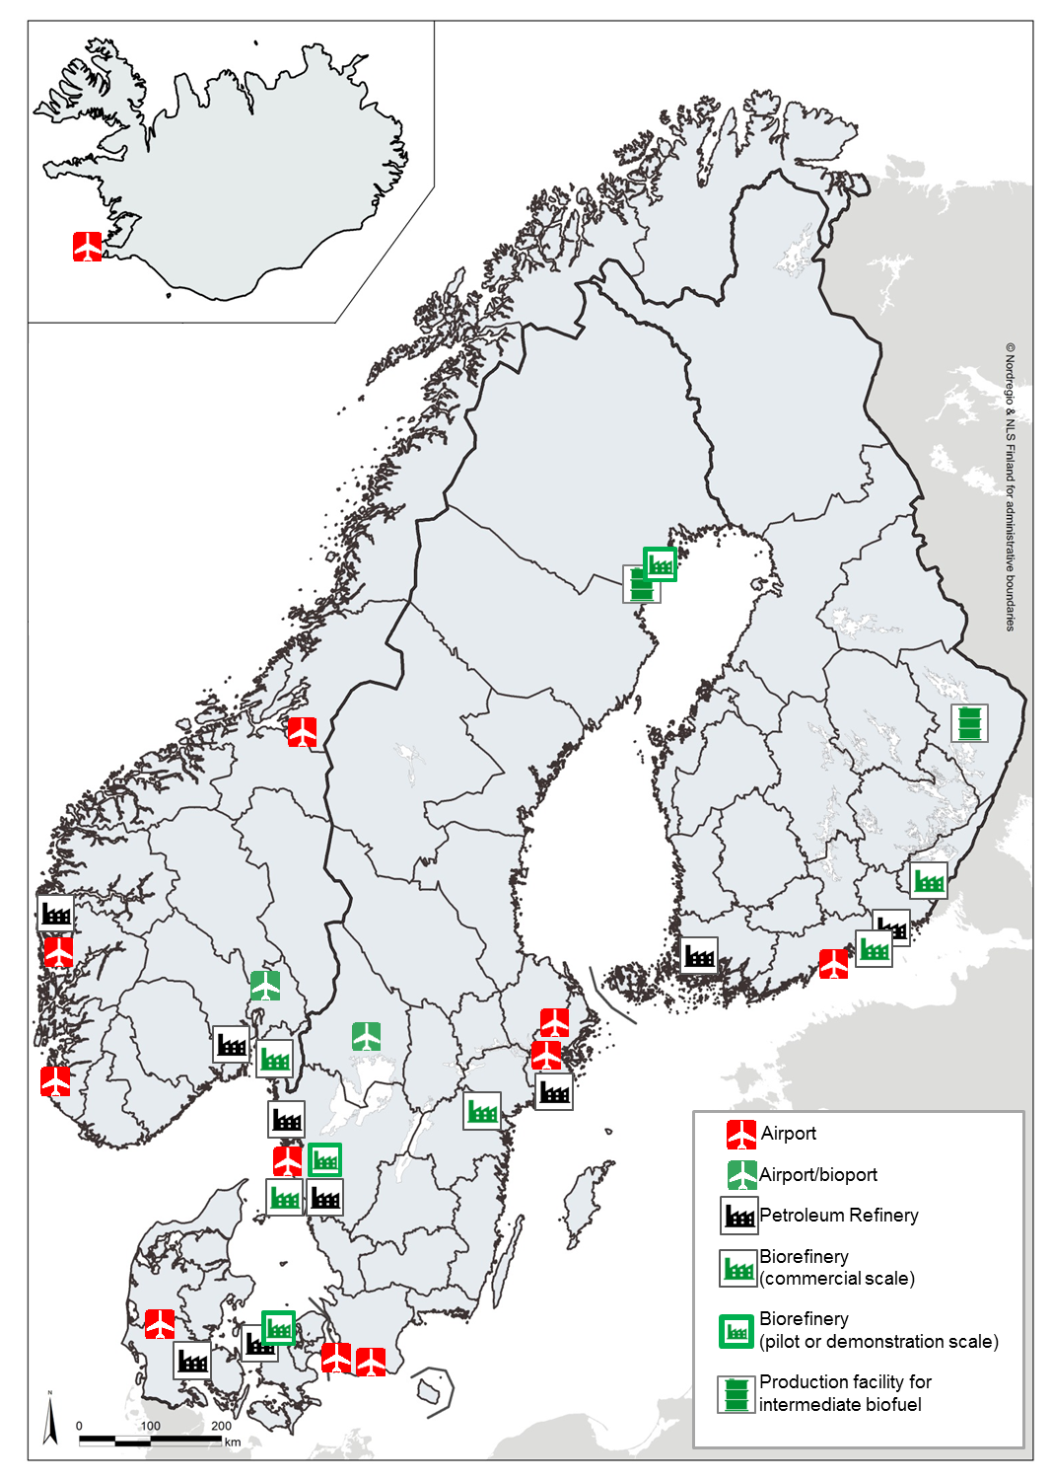
Nordic Energy Infrastructure
Nordic petroleum refineries

Slide 13
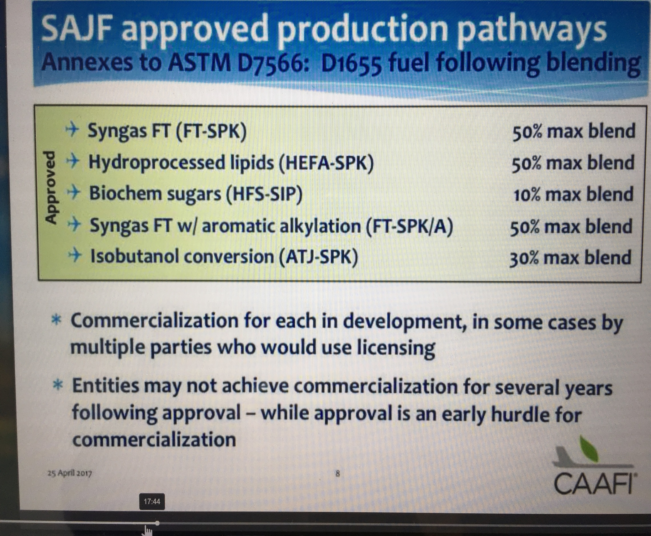

Slide 14
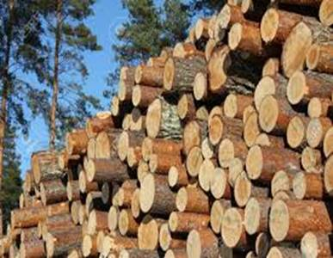
The biomass is there
Residuals
Wood and forest residuals exist in a wide variety of shapes and content from many side streams of forestry and pulp and paper production. Also the agriculture, industrial- and household waste represent viable feedstocks

Slide 15
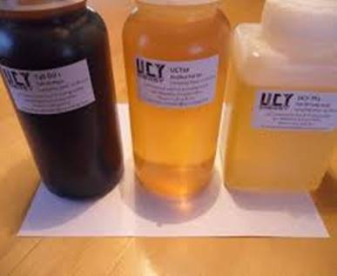
The facilities are there
Production
More than 13 possible conversion pathways are identified. Some at a commercial scale - others only at pilot scale or earlier Neste is the only company who have produced bio-based jet fuel in the Nordics - and only in agreed batches.

Slide 16
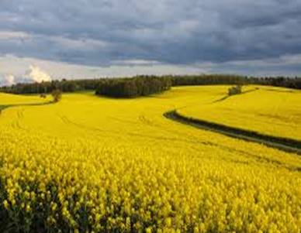
We have the knowledge
Nordic analysis
We have strong competencies and the necessary technical know-how within different pathways. Competencies in refining technology is in place and so are the infrastructure On the aviation side airline companies and airports show a high willingness to use biofuel in aviation

Slide 17

Nordic sustainable jetfuel
Big volumes
Estimated that production pathways should be matured in 2020. The blend-in level must be of 1,2% in 2020 corresponding to 65 million liters in the Nordic countries To reach CO2 reduction of 50% in 2050, approximately 2 billion liters of sustainable jet fuel are required

Slide 18
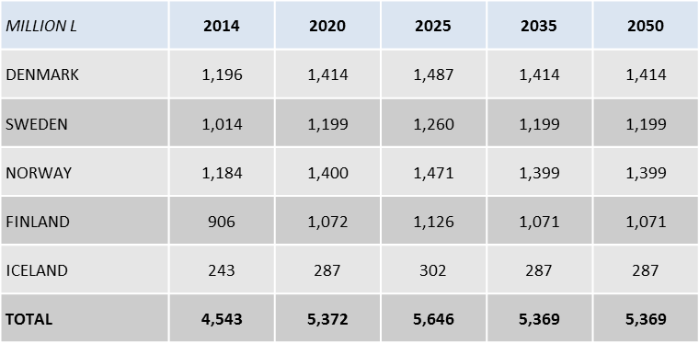
NORDIC DEMAND FOR JET FUEL
Nordic countries aggregate consumption: from roughly 4 million m³ in 2010 to 4.5 million m³ in 2014
Gradual increase up until 2025, where the Nordic demand for jet fuel peaks at roughly 5.7 million m³.
After 2025, the demand stagnates reaching a steady state of an aggregate annual demand of 5.4 million m³ in 2030 and onwards.
PROJECTION OF NORDIC DEMAND FOR JET FUEL UP UNTIL 2050
(NIRAS 2016)

Slide 19
NORDIC DEMAND FOR SUSTAINABLE JET FUEL
Because of the price gap, demand will be led by the global aviation industry’s GHG emission targets and the industry’s four pillar strategy for meeting set targets
Initial Nordic annual demand for sustainable jet fuel could reach 65 million l in 2020, reaching 2 billion l in 2050, corresponding to 37.5 % of total demand.
A 3% blend-in of sustainable jet fuel corresponds to a 2% reduction in GHG emissions.
Thus, in order to reach a GHG emission reduction of 25% through the use of biofuels, a blend-in ratio of 37.5% is required by 2050.
million l | 2020 | 2025 | 2030 | 2035 | 2040 | 2045 | 2050
DENMARK | 17 | 108 | 188 | 274 | 359 | 445 | 530
SWEDEN | 15 | 91 | 160 | 232 | 305 | 377 | 450
NORWAY | 17 | 107 | 186 | 271 | 355 | 440 | 525
FINLAND | 13 | 82 | 143 | 207 | 272 | 337 | 402
ICELAND | 3 | 22 | 38 | 56 | 73 | 90 | 108
TOTAL | 65 | 410 | 714 | 1,039 | 1,364 | 1,689 | 2,014
FUTURE DEMAND FOR SUSTAINABLE JET FUELS IN NORDIC COUNTRIES
(NIRAS 2016)
Source: Own estimates, based on extracts from Eurostat.

Slide 20
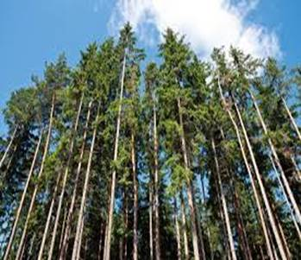
We can’t do it on our own
Call for action
We need the politicians and the producers to prioritize the development and the production of sustainable jet fuel. The aviation sector calls on politicians to put sustainable jet fuel high up on the agenda. The subject should be part of national energy policies

Slide 21
Nordic Sustainable jetfuel Initiatives
Commercial flights on sustainable jetfuel:
  Finnair, SAS, Norweigian, Nextjet and BRA (2016/17)
Aviation biofuel supply:
  Avinor, Norway 2016
  Swedavia, Sweden 2017
Studies/reports:
  Norway, 2014 and 2017, Denmark 2015, Sweden 2015, Finland 2016, Nordic Report/NISA+NIRAS 2016
Projects and feasibility study:
  City of Copenhagen, Climate KIC, NISA and Swestep
FGF/Fly Green Fund:
  Karlstad Airport, SkyNRG and NISA 2015-
Norway Stortinget, decision 2017 1% blend-in 2019 – 30% blend-in 2030
Swedish decision 2017, investigation on sustainable jetfuel
Nordic leadership in aviation emissions reductions 10. Oct, Copenhagen Airports/NISA/NER:

Slide 22
CORE RECOMMENDATIONS
Include aviation in National Energy Plans for EU (winter package) /RED 2
Encourage corporate, private and public use of sustainable jet fuels (a Nordic Fly Green Fund?)
Include sustainable jet fuel in public procurement with sustainability criteria (military (fuel) and public entities (flights)
Explore opportunities in public-private partnerships to establish best possible conditions for funding, pilot/demo plants a.m.
Evaluate the possibilities in a Nordic pre-qualification- or tender process for sustainable jet fuels
High priority to negotiations on aviation- and climate issues in international bodies

Slide 23
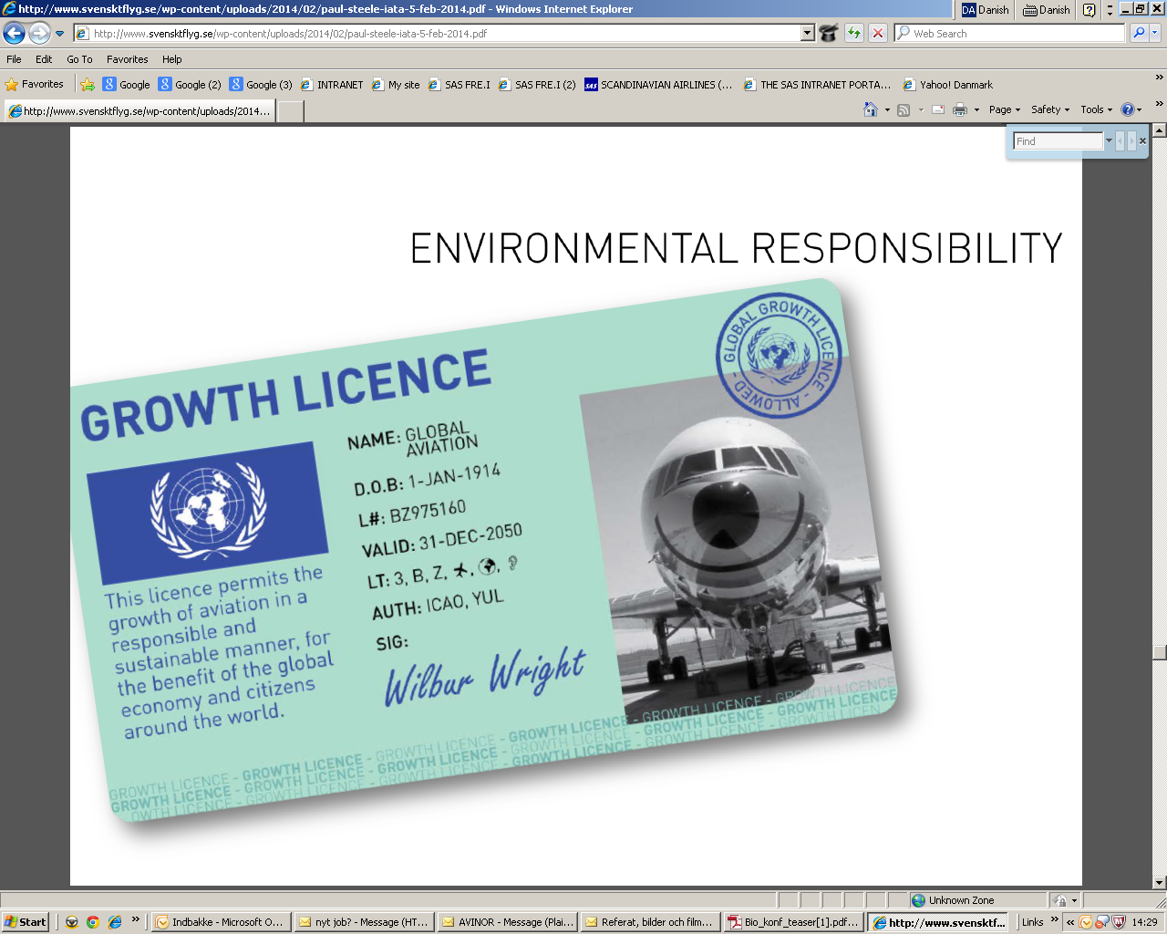

Slide 24
Nationella särregler och flygskatt är inte en effektiv lösning på något miljöproblem – det är ett hot mot tillgänglighet och jobb. Om alla t.ex. höll laglig hastighet på våra vägar, skulle vi minska utsläppen mer än vad inrikesflyget släpper ut på ett år. (Källa: Trafikverket)
Utsläppen från allt svenskt inrikesflyg är ca 500 000 ton per år
Utsläppen på grund av hastighetsöverträdelser på svenska vägar är ca 700 000 ton per år
Utsläppen på grund av fel däckstryck i svenska fordon är ca 300 000 ton per år

Slide 25
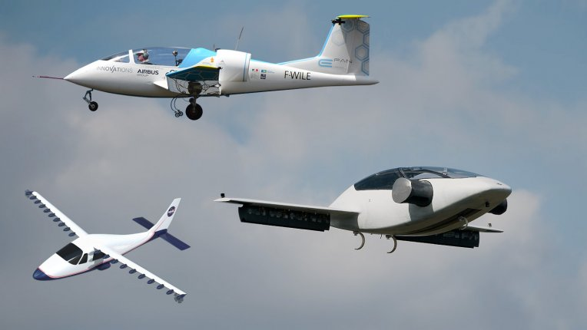
El powered aircraft

Slide 26
UN ICAO 39th General Assembly: Global MBM scheme:
Carbon Offsetting and Reduction Scheme for International Aviation (CORSIA) to address any annual increase in total CO2 emissions from international civil aviation
2019 and 2020 basis for carbon neutral growth from 2020, against which emissions in future years are compared. From 2021 when emissions covered by the scheme exceed the average baseline emissions of 2019 and 2020, this difference represents the sector's offsetting requirements for that year
Pilot phase (from 2021 through 2023) and first phase (from 2024 through 2026) would apply to States that have volunteered to participate in the scheme
As of 31​ May 2017, 70​​​ States, representi​ng 87​.7​​​​​% of international aviation activity, voluntarily participate in the global MBM scheme from its outset.
Second phase (from 2027 through 2035) would apply to all States that have an individual share of international aviation activities in RTKs in year 2018 above 0.5 per cent of total

Slide 27
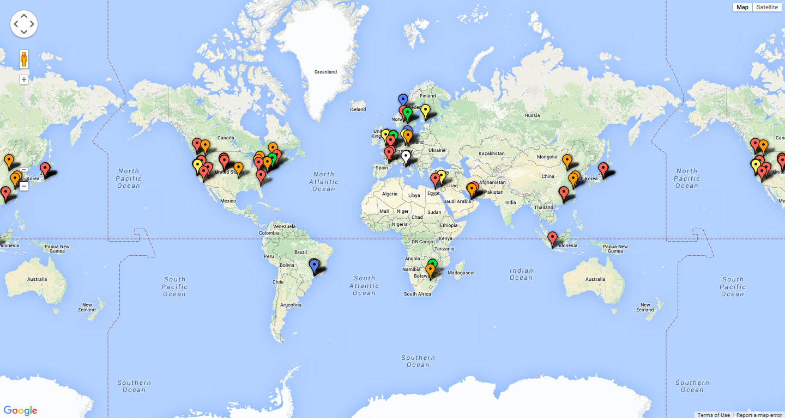
Sustainable jetfuel activities globally

Slide 28
OUR ENVIRONMENTAL VISION IS TO BE A PART OF LONG-TERM SUSTAINABLE SOCIETY
IT SHOULD BE POSSIBLE TO FLY WITH NO FOSSIL-FUEL CO2 EMISSIONS BY 2050
Front cover of SAS' yearly Report 2015

Slide 29
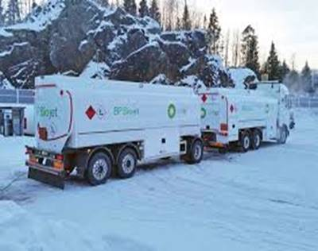
We can’t do it on our own
On the political agenda
Launch initiatives to kick-start and stimulate the maturing and upscaling of the market for sustainable jetfuel. + Coordinate with international initiatives, - ICAO, IATA, EU-RED

Slide 30
Recommendations from the Nordic Report
Explore the possibilities to make specific targets for the share of renewable energy sources (RES) in aviation on all levels Promote public-private partnership between the aviation sector, jet fuel producers, universities and other public entities, in order to increase transparency and lower the risk in investing in sustainable business models. | Policy makers should explore possibilities for establishing a mechanism for producers of sustainable jet fuels, in order to secure transition investment capital Organize the individual technologies and their developers in collaboration around specific production pathways throughout the value chain Explore and stimulate possibilities for co-processing with existing facilities, especially oil refineries

Slide 31
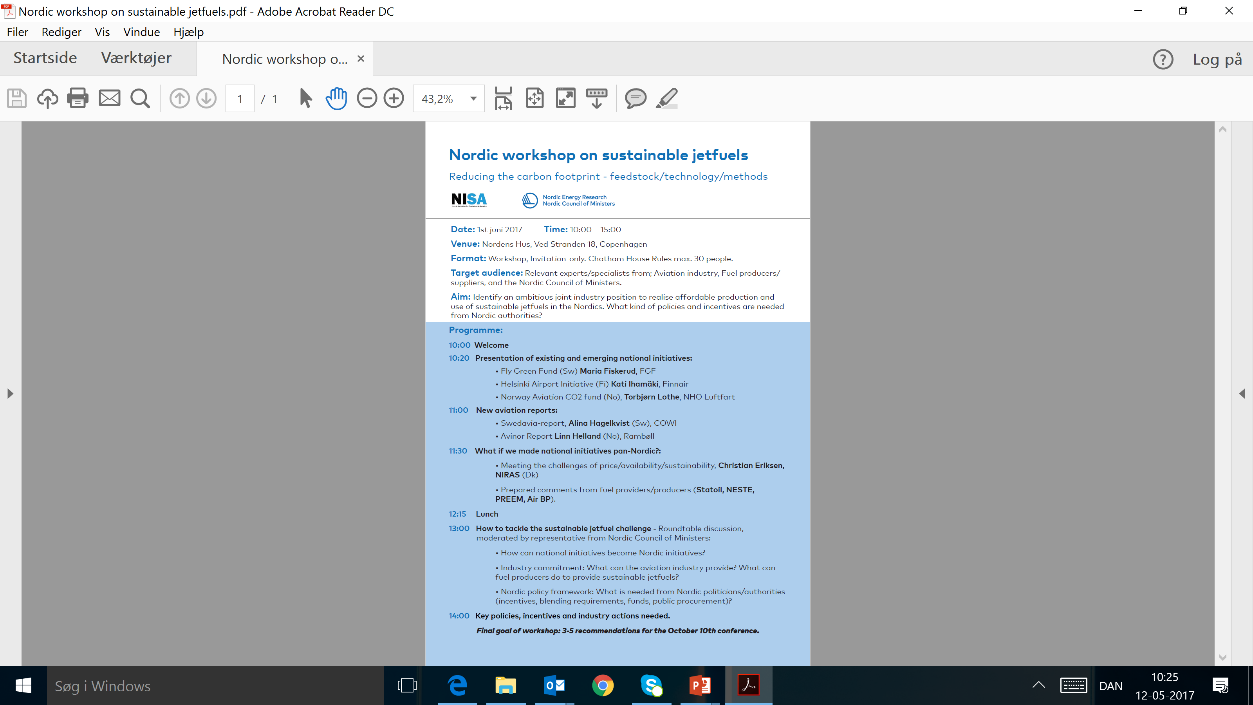

Slide 32


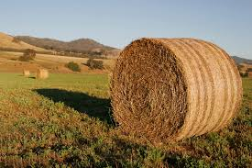
The market today
No fully functioning commercial supply chain for sustainable jet fuel.
Increasing number of commercial flights operate worldwide on a blend of commissioned biofuels.
Nordic countries: leader on this field in Europe.
US: Likely stable commercial production in the near future.
A number of companies are supplying and developing technologies that are either commercially used to some extent or could see increased future potential given technological development. While such technologies may seem to offer promising new solutions, they are generally on a lower level of maturity.
In the last decade: 80 multi-stakeholder initiatives. Some terminated, due to various challenges facing the commercial markets.
BACKGROUND
DEMAND
PRODUCTION
SCENARIOS
IMPACT
BARRIERS
CONCLUSION

Slide 33
Today’s commercial producers of alternative jet fuel
Since January biofuel has been available on the Oslo airport in Norway and the delivered fuel produced at a refinery in Porvoo, Finland.
US: Fulcrum Bioenergy, GEVO, Red Rock Biofuels and AltAir, have agreements with airlines for the supply of larger fuel amounts -> Likely stable commercial production in the US in the near future.
‘*’ denotes that the capacity is planned rather than existing. ‘–‘ denotes that the production capacity (of jet fuel) is unknown.
BACKGROUND
DEMAND
PRODUCTION
SCENARIOS
IMPACT
BARRIERS
CONCLUSION

Slide 34
NORDIC DEMAND FOR sustainable JET FUEL
Because of the price gap, demand will be led by the global aviation industry’s GHG emission targets and the industry’s four pillar strategy for meeting set targets
Initial Nordic annual demand for sustainable jet fuel could reach 65 million l in 2020, reaching 2 billion l in 2050, corresponding to 37.5 % of total demand.
A 3% blend-in of sustainable jet fuel corresponds to a 2% reduction in GHG emissions.
Thus, in order to reach a GHG emission reduction of 25% through the use of biofuels, a blend-in ratio of 37.5% is required by 2050.
million l | 2020 | 2025 | 2030 | 2035 | 2040 | 2045 | 2050
DENMARK | 17 | 108 | 188 | 274 | 359 | 445 | 530
SWEDEN | 15 | 91 | 160 | 232 | 305 | 377 | 450
NORWAY | 17 | 107 | 186 | 271 | 355 | 440 | 525
FINLAND | 13 | 82 | 143 | 207 | 272 | 337 | 402
ICELAND | 3 | 22 | 38 | 56 | 73 | 90 | 108
TOTAL | 65 | 410 | 714 | 1,039 | 1,364 | 1,689 | 2,014
FUTURE DEMAND FOR SUSTAINABLE JET FUELS IN THE NORDIC COUNTRIES
Source: Own estimates, based on extracts from Eurostat.

Slide 35

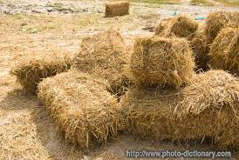
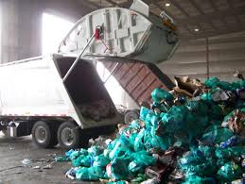
Feedstock production
The most ideal candidates in the foreseeable future, with respect to availability and price, are wood residuals, wheat straw and waste fractions.
Heavy competition from alternate uses in production of heat and power and biofuels for road transport.
Other sources of feedstock are also possible, but not currently available in any significant amount in the region. (energy crops and marine resources, such as seeweed and algae. May later become available, given developments)
Many of the feedstock candidates can potentially be imported from countries outside the Nordics, though the same issues of competing markets are expected to limit availability.

Slide 36

Sustainability is key
(Corporate social responsibility)
SAFUG
Exhibit minimal impact on biodiversity
• Meet a sustainability standard with
respect to land, water, and energy
use
• Do not displace or compete with food
crops
• Provide a positive socioeconomic
impact
• Do not require any special fuel
handling equipment, distribution
systems, or changes to engine
design
Not just a word - but a safeguard for a growing future aviation
      Push for solid sustainability criteria for biomass and processes
      Total sustainable supply chains
      Sufficient Life Cycle Analysis
Encourage the development and adoption of a global sustainability standard (RSB)

Slide 37
Regional Biofuel-consortia/initiatives established
Brazilian Alliance for Aviation Biofuels, ABRABA Brazil
Aviation Initiative for Renewable Energy in (AIREG) (Germany)
AlfaBird, Sustainable Way for Alternative Fuels in Aviation and Flight Path 2020 (EU)
Initiatives for the Production and Consumption of Biojet Fuel for Aviation (Spain)
Saltwater Tolerant Biomass As A Source of Aviation Fuel, (Abu Dhabi)
Commercial Aviation Alternative Fuels Initiative (CAAFI) (US)
Flight Path to Sustainable Aviation Fuels CSIRO (Australia and New Zealand)
NISA, The Nordic Countries
Also initiatives in Indonesia, China, Mexico, Qatar, Italy and more….
Airbus and Boeing, - several engagements globally, - and as well ICAO and IATA of course plays overall coordinating and supporting roles

Slide 38
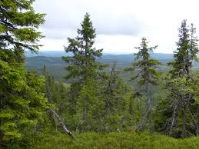
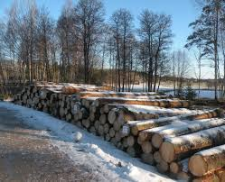
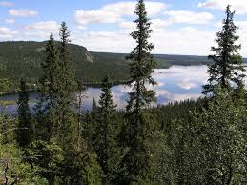
SWEDEN
2020 goal reached. 50% renewable energy, 10% in road transport by 2020 (aviation exempted)
2030 goal: A vehicle fleet independent of fossil fuels. 2050: No net emissions
Working on a national strategy towards sustainable aviation
2005: adopted act on the obligation to supply renewable fuels.
Related tools: carbon and energy taxes, electricity certificate system, the “pump act”, car taxation measures and subsidies promoting sustainable fuels and vehicles using renewable fuels or electricity
Large number of potential actors, but only a few are actually involved
BACKGROUND
DEMAND
PRODUCTION
SCENARIOS
IMPACT
BARRIERS
CONCLUSION

Slide 39
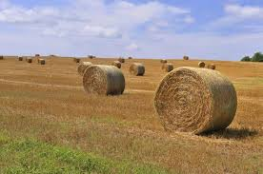
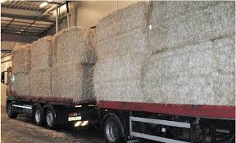
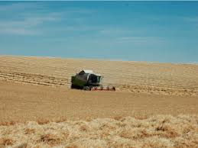
DENMARK
2020 goal: RES is 30% of gross final consumption of energy, 10 % share of RES in energy for transportation
2050 goal: follows EU, but transport sector independent of fossil fuels
No national initiatives targeting the advancement of sustainable jet fuel.
A range of private and public Danish entities are members of transnational initiatives, such as NISA.
Spends DKK 1 bn on research, development and demonstration-projects within the energy sector
Assigns a significant proportion of biofuel energy inputs to the aviation sector in its future plans for the Danish energy system.
Danish Resource Strategy: Explicitly mentions the use of organic waste to increase bioenergy production.
BACKGROUND
DEMAND
PRODUCTION
SCENARIOS
IMPACT
BARRIERS
CONCLUSION

Slide 40
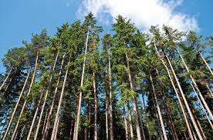
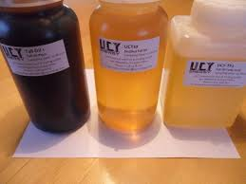
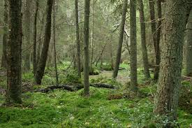
FINLAND
2020 goal: 38 % of gross final consumption of energy, 10 % share of RES in energy for transportation. Has unilaterally increased the target share of RES in transportation to 20 % by 2020
Establish distribution infrastructure for alternative power sources in aviation by 2020
Innovations in fuel technology plays an important part of lessening the outflow of capital to oil producing countries and boosting export of Finnish clean tech
Finland is ”extremely well-positioned to be among the first in the world to start extensive, continuous use of biofuels in aviation” (MTC, 2014)
Issue of covering incremental costs of biojet production - 3 year model: Public subsidies cover 45% of incremental costs for “frontrunner companies”
BACKGROUND
DEMAND
PRODUCTION
SCENARIOS
IMPACT
BARRIERS
CONCLUSION

Slide 41
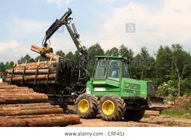

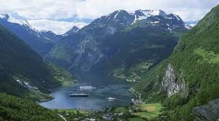
NORWAY
2020 target: 67.5 % share of RES of gross final consumption of energy. 10 % share of RES in energy for transportation.
Identifies FT and AtJ as suitable pathways for a Norwegian production of sustainable aviation fuels
Study projects that the FT pathway could be price competitive (on a commercial scale) by 2021, however dependent on commercializing the byproducts of sustainable aviation fuels production
Conversion rate is one of the main drivers for profitability in the processes
Projections imply that AtJ will not be costs competitive vs. fossil jet fuels until after 2030
BACKGROUND
DEMAND
PRODUCTION
SCENARIOS
IMPACT
BARRIERS
CONCLUSION

Slide 42
ICELAND
2020 goal: share of 73% of gross final consumption of energy, 10 % share of RES in energy for transportation
No national initiatives with regards to sustainable jet fuel in Iceland
Lack of feedstock production
Access to low-cost energy
Potential for hydrogen-production
Icelandic National Renewable Energy Action Plan aims to enable Iceland to lead the way in coming years in experiments and production of sustainable energy sources, in part by supporting research and development and building up infrastructure
BACKGROUND
DEMAND
PRODUCTION
SCENARIOS
IMPACT
BARRIERS
CONCLUSION

