Slide 1

Icelandic Transport Authority
Samgongustofa
N-ALM/58
29th-31st May 2017
Halla S. Sigurdardottir
Deputy Director General –
Director of Facilitation and Coordination

Slide 2
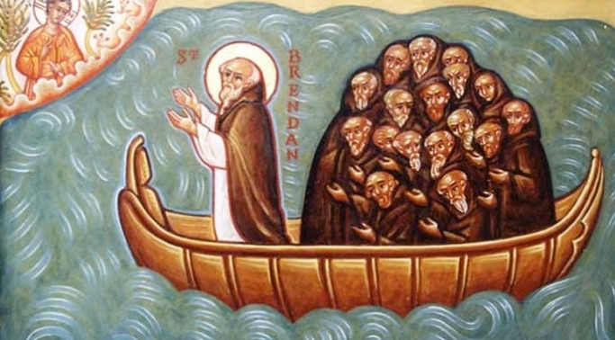
Very brief facts
870 – 930 The last European Country to be settled
Notes:
Before telling you about Icelandic Transport Authority and our challenges, I would like to use this opportunity to tell you a few historcal facts about Iceland.
The first people to settle here were probably irish munks. Most likely they stayed here for few years but were then wise enough to take back again.

Slide 3
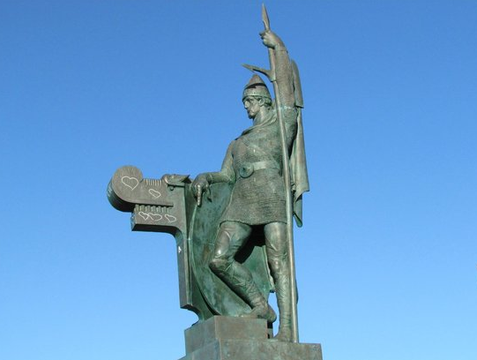
Notes:
The first confirmed Icelander, according to history books was Ingólfur Arnarsson. He came from Norway. This is him as we want you to think how he looked like.

Slide 4

Notes:
The first Icelandic woman was his wife, Hallveig Fróðadóttir. Since she was a woman, we do not have any statue of her.

Slide 5
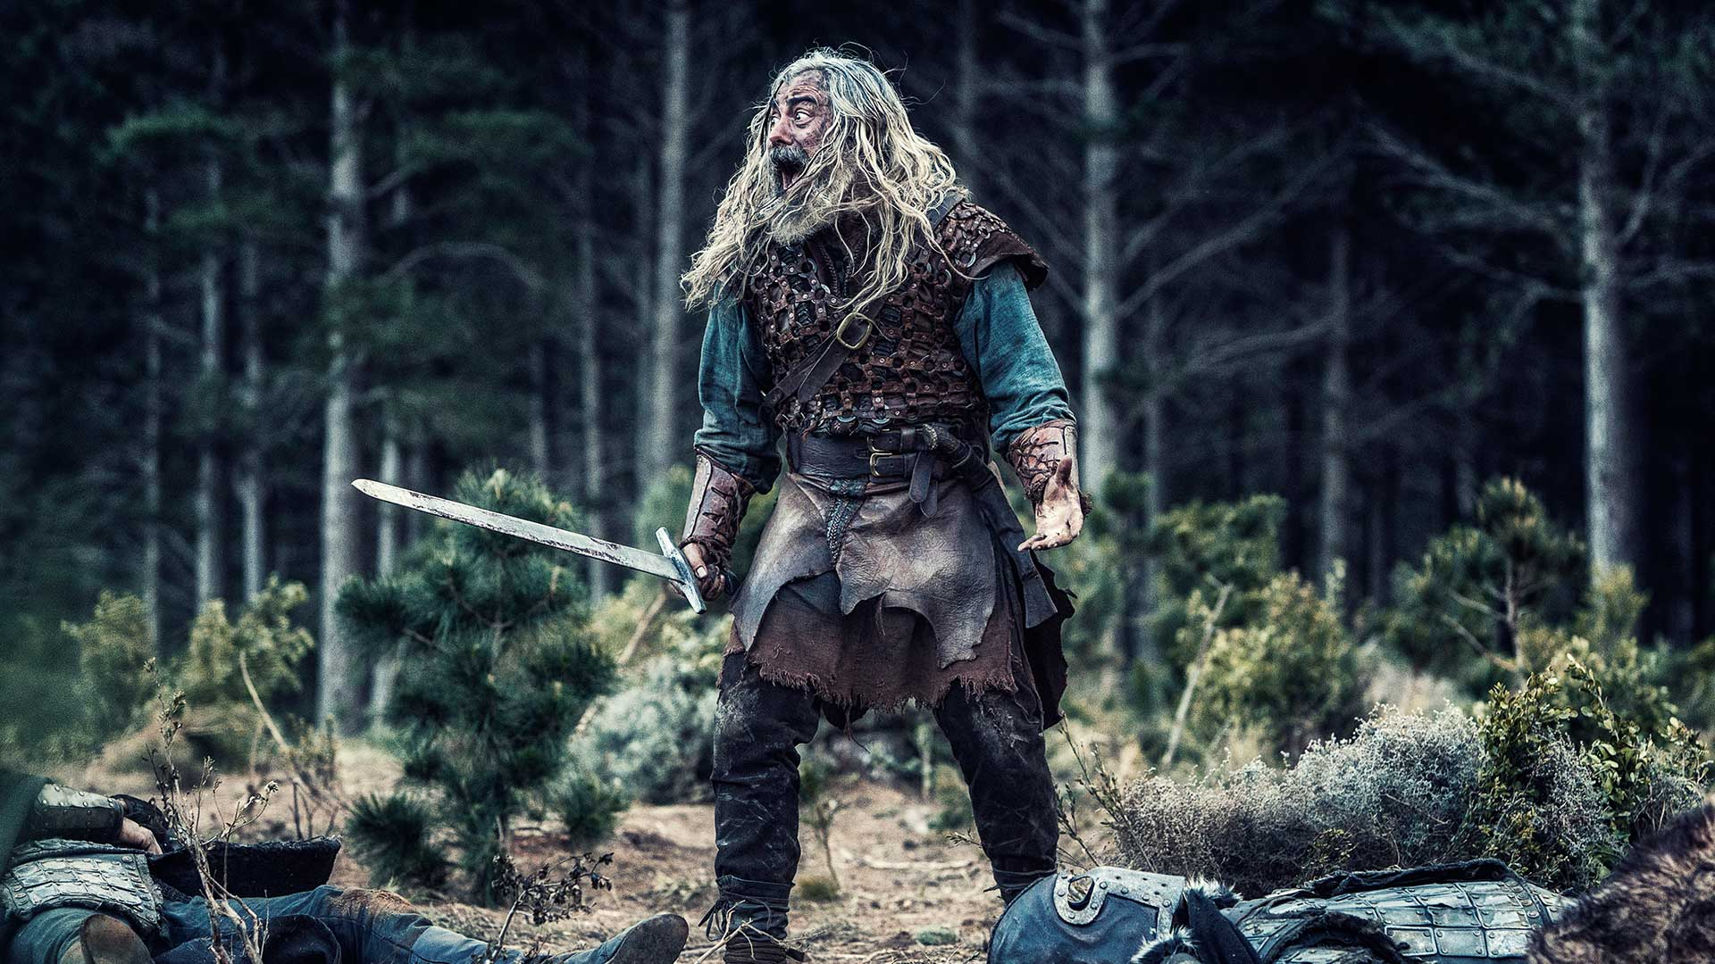
Notes:
But this is how he probably really looked like.

Slide 6
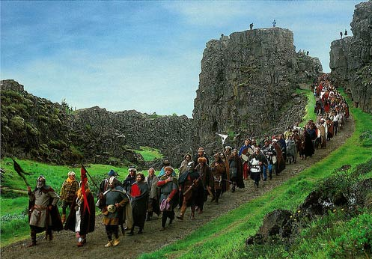
930 - Establishment of the parliament – Althingi
Notes:
Iceland has the oldest continuous existing parliament in the world. Its assemblies were conducted at Þingvellir and lasted typically for two weeks in June.

Slide 7
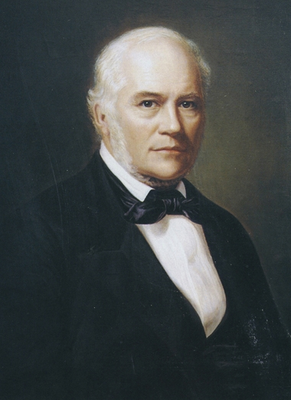
Notes:
In the year 1380 Iceland, with Norway, became part of the Danish crown
In 1944 Iceland became independent state
Our national independence leader was Jón Sigurðsson, this guy, often referred to as the first president of Iceland. His birthday, June 17th is our national holiday.

Slide 8
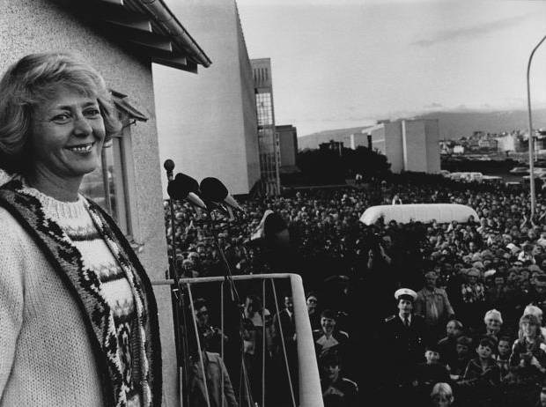
Notes:
Vigdís Finnbogadóttir was the worlds first democratically directly elected female president, elected 1980.

Slide 9
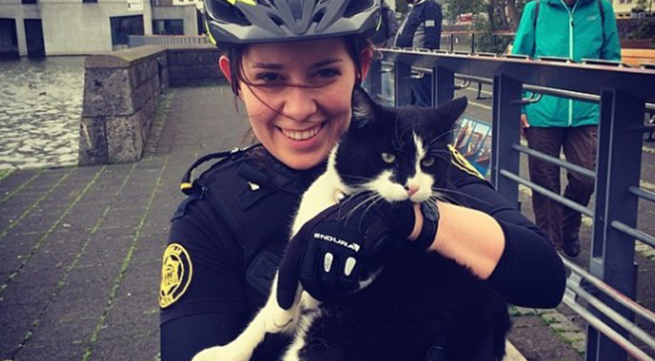
Notes:
Iceland does not have any army, navy or air force. The Icelandic police do not carry guns.

Slide 10
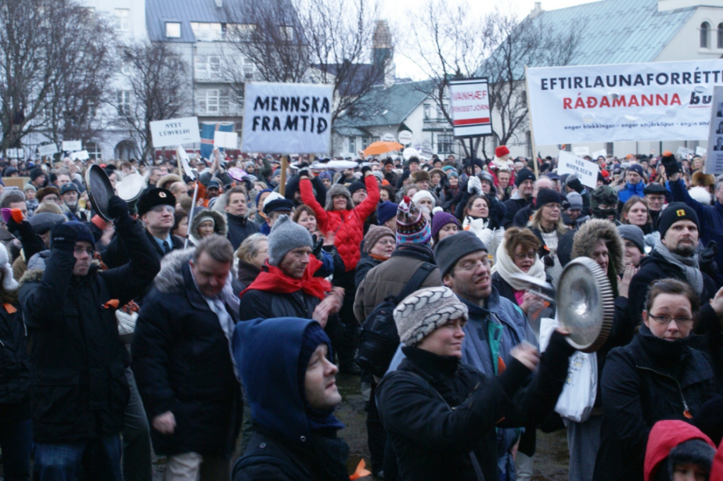
Notes:
Now we go a little bit back in time. In 2008, the economic crisis hit hard on the world and the situation for icelandic nation was critical. Common icelandic people were extremely worried about the future. We even had our own revolution, which finally led to the fall of the government. People brought their pots and pans to Alþingi and made a lot of noise and trew eggs on the house. This revolution is known as the kitchenware revolution.

Slide 11
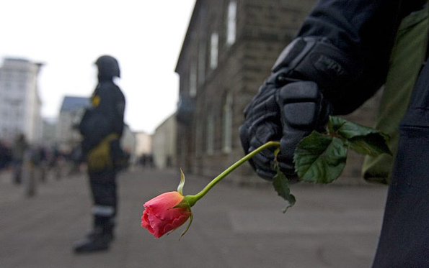
Notes:
Of course we are joking a little, the situation was in fact serious and people got hurt, mainly financially. But in spite of this difficult situation, most people kept calm and did not use any violence.

Slide 12
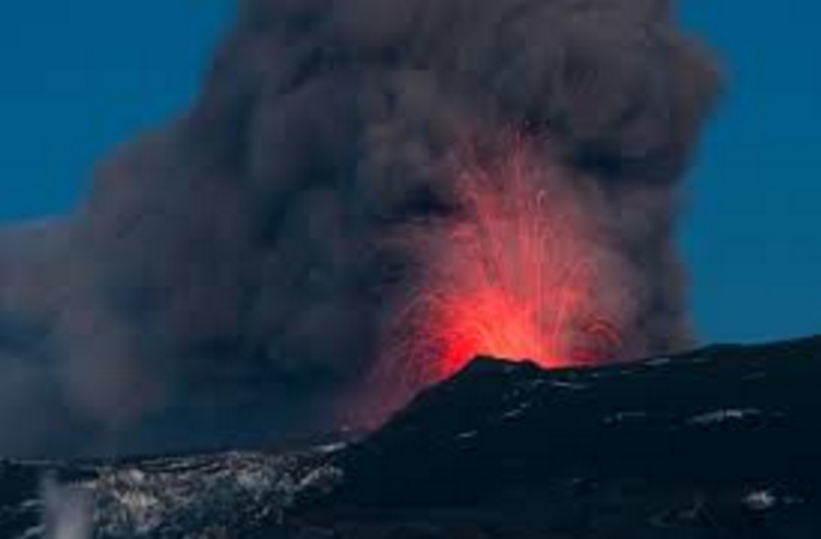
Notes:
But then this happened! Everybody say with me: Eyjafjallajökull.
Yes, we got a real volcano eruption. Again, nobody was killed, but a lot of flight all over Europe got cancelled. Which is why this eruption got very much national attention.

Slide 13
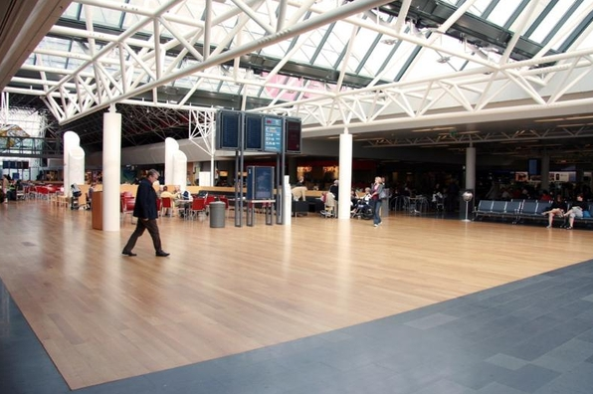
Notes:
Here we have Keflavik airport before Eyjafjallajökull.

Slide 14
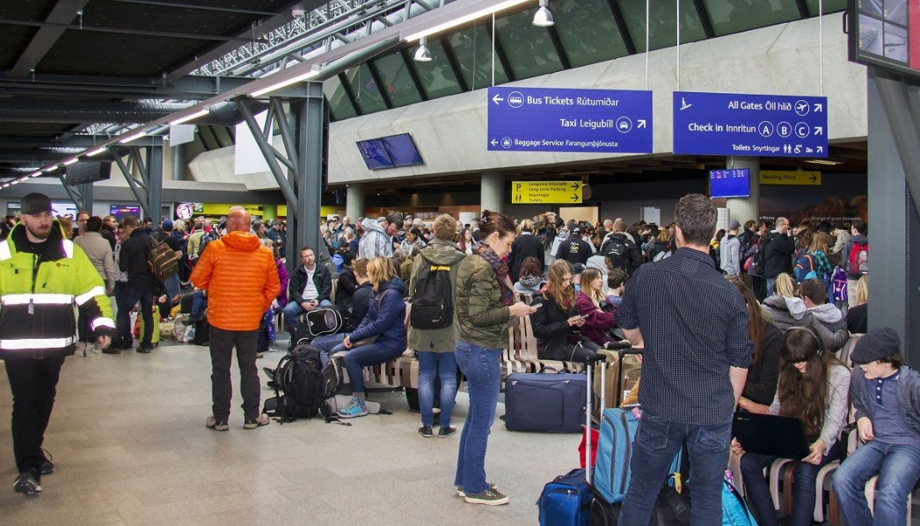
Notes:
And here we see it after Eyjafjallajökull.

Slide 15
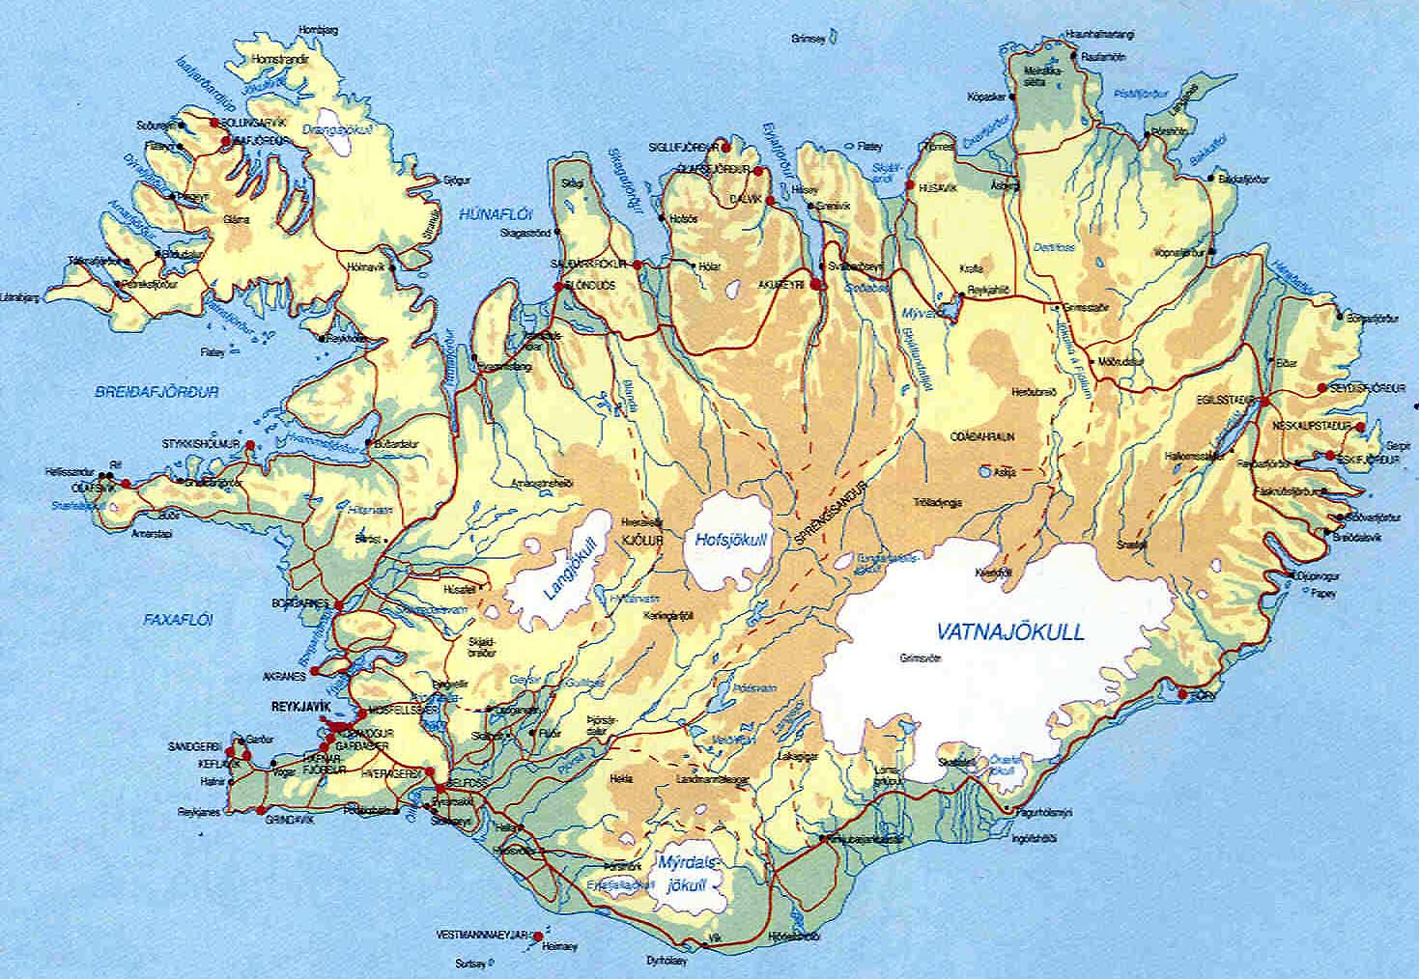
Iceland in numbers
Area approximately 103.000 km²
The most sparsely populated country in Europe – 80% uninhabited
Population January 1st 2017: 338.449
Population in Reykjavik area: 213.619
Economic growth 2016: 7,2%
Unemployment, February 2017: 3,2%

Slide 16
Very brief historical facts
870 – 930 The last European Country to be settled
Establishment of the parliament – Althingi
Oldest continuous existing parliament in the world
1380 Iceland, with Norway, became part of the Danish crown
1918 Iceland becomes independent state
1919 First flight in Iceland (AVRO 504K)
1929 First Aviation Act passed by parliament
1944 The Modern Republic of Iceland is established
1944 Iceland signed the Convention of International Civil Aviation
1945 ICAA established.
The first international flight by Icelandic aircraft (Catalina seaplane to Scotland)
1960´s Loftleidir: First low-cost airline between Europe and America

Slide 17





Merger of Transport Authorities – 1 July 2013
Icelandic Civil
Aviation
Administration
Road Traffic
Directorate
Icelandic Maritime
Administration
Icelandic Road
Administration
100%
100%
60%
40%
5%
95%

Slide 18
Governmental Structure
Ministry of the Interior
Transport Council Advisory Boards on Road Traffic, Maritime and Aviation Affairs
Accident
Investigation
Board
Isavia ohf.
Aerodromes and
Air Navigation
Icelandic Transport Authority
Icelandic Road
Administration
Roads, Lighthouses
and Harbors
Transport Council

Slide 19
International Airports
Akureyri
Egilsstaðir
Reykjavik
Keflavik

Slide 20
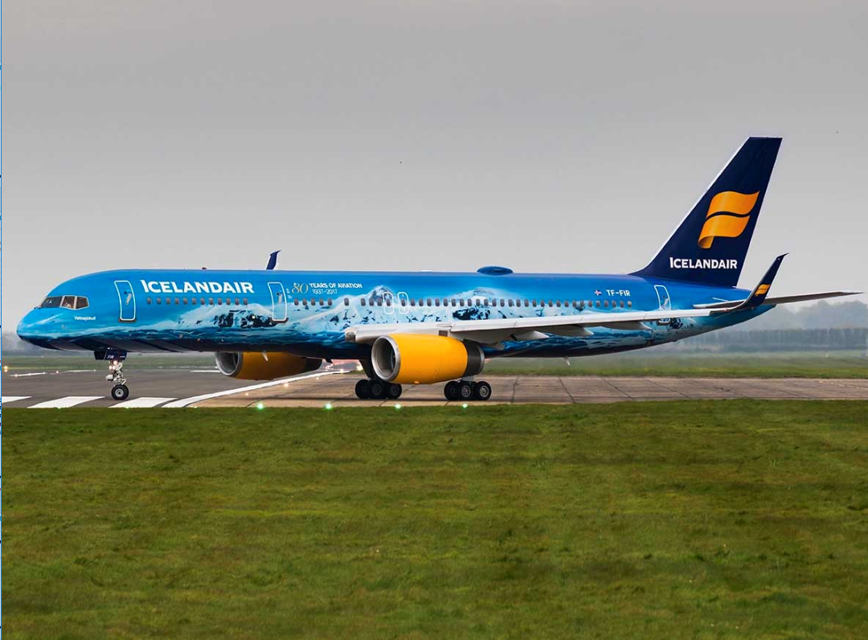

Slide 21
Aviation Structure in Iceland
Icelandic Transport Authority
Regulatory body
Entry control and continuous oversight
Airspace management
Support to Ministry in the field
of aviation and monitoring of fulfillment of international obligations
National Supervisory/Aviation Authority (NSA/NAA),
Service Providers
ANSPs: Isavia, Icelandic Met Office (IMO)
Aerodromes: Isavia
Aviation Industry
AOC – Holders
Training organisations
Maintenance organisations
CAMO

Slide 22
Responsibilities
  ICETRA is responsible for the administration and supervision of aviation, maritime and road traffic safety and the safety and supervision of transport infrastructure and navigation systems.
  ICETRA is subject to the Ministry of the Interior and is intended to contribute to safe, sustainable, accessible
  and economical transport.

Slide 23
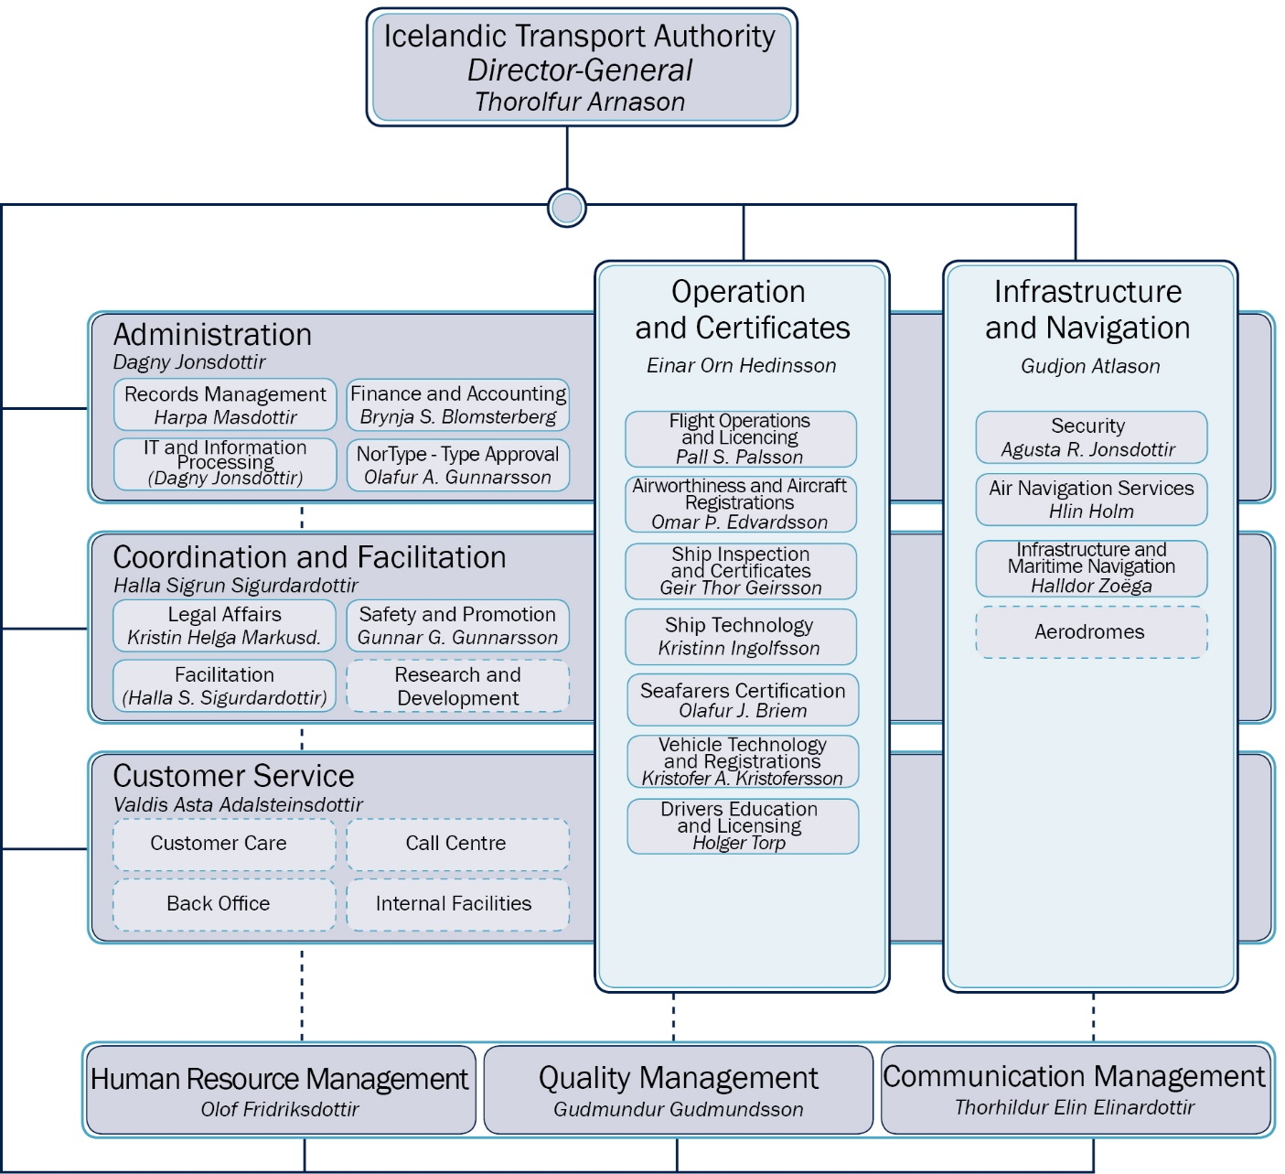

Slide 24
Aviation Related

Slide 25
Ministry of the Interior
Icelandic Transport Authority
Coordination and Facilitation
Infrastructure and Navigation
Operation and Cert.
(OPS, FCL, AIR)
Administration
Safety and Promotion
Aircraft incidents and risk analysis
Air Navigation Services
Air Traffic Services - ATS; AIS; Navigation Systems; CNS; Metrological Services - MET
Airworthiness and Aircraft Registrations
CoA; Continuous Airworthiness
Customer Service
Aircraft Registrations
Legal Affairs
Legal support
Aeorodromes
International and Domestic Aerodromes; Airstrip
Flight Operations and Licensing
Commercial Air Transportation; General Aviation; Training Organisations; Medical Certificates; AMS; DG
Facilitation
Transport strategy, environment, coordination

Slide 26
Staffing
  The human resources policy supports the overall organisation and is based on the values positivity, professionalism, trust and respect.
  The goal is that both management and employees contribute to the policy and bear collective responsibility to provide efficient monitoring and quality service.
  ICETRA employs 140 permanent staff members with a broad education and knowledge background; 55 women and 85 men.

Slide 27
Approved organisations
6 AOC holders operating a/c > 10 MTOM
  Air Iceland 9 (F50, DHC8)
  Air Atlanta Icelandic 16 (A340, B747-400)
  Bluebird Cargo 6 (B737-300/400)
  Icelandair 32 (B757/767)
  Icelandic Coast Guard 1 (DHC8)
  WOW Air 11 (A320 series, A330)
5 AOC holders operating a/c <10 MTOM
2 Declared SPO operators a/c < 10 MTOM

Slide 28
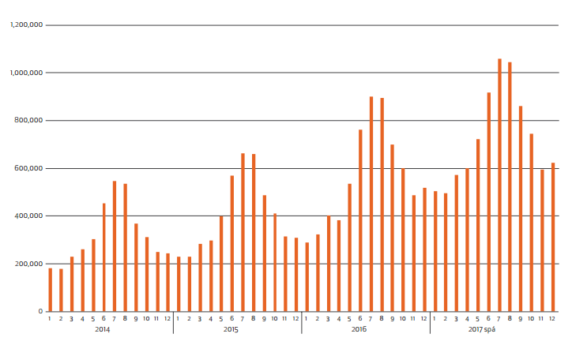
Notes:
This graph shows the increse of passengers in Keflavik airport and the forecast for this year. The results of this tourist boom are very many.

Slide 29
Growth in aviation in Iceland
Number of inspections

Slide 30
Growth in aviation in Iceland

Slide 31
Growth in aviation in Iceland

Slide 32
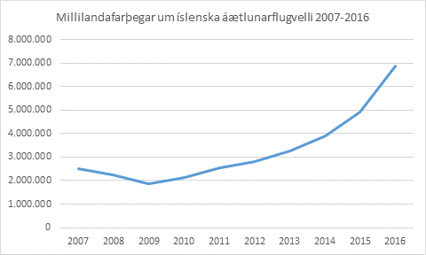
Growth in aviation in Iceland
Number of passengers in commercial transportation

Slide 33
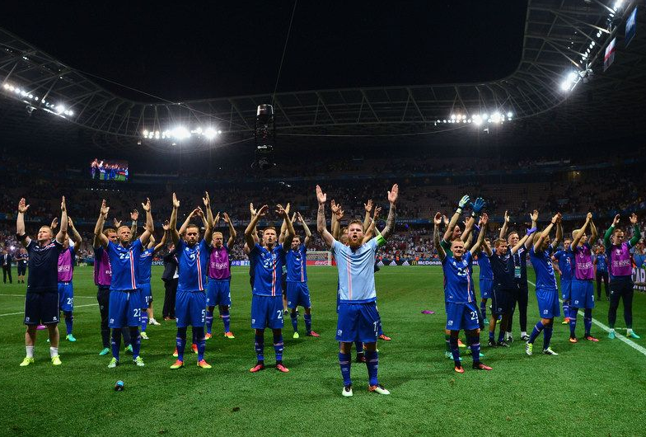
Notes:
Do you remember this? Same guys.

Slide 34
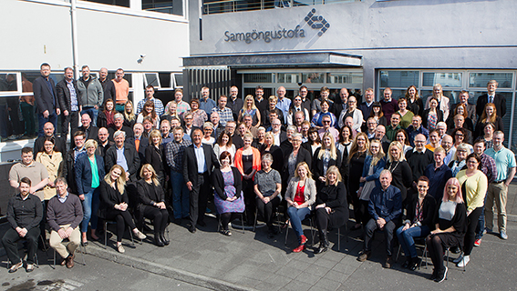
Thank you!

